Slide 1
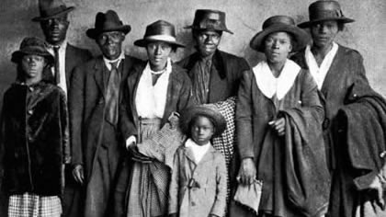
Blacks and Our Pursuit of the American Dream: An Analysis of The Great Migration of Blacks and Wealth
By: Tanea Taylor

Slide 2
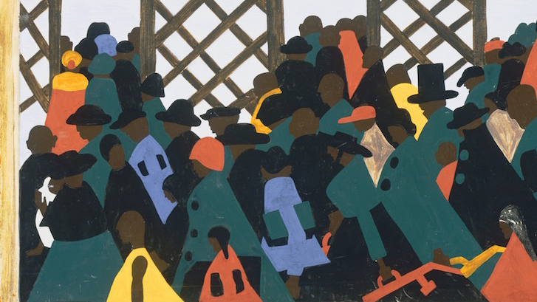
Problem Statement
I am analyzing the geographical and economic effects of three Great Migrations. The goal is to observe the correlation of the Great Migrations of Blacks and how it aided the economic growth for the race.
This is important because studying the history of growth within the Black community can also further aid and push more economic growth within the community as well. Even though times have changed, there is still a substantial gap in the economic status of Blacks vs other races within the United States. These findings will also inevitably reveal how Blacks utilized The Great Migrations to better their economic standings.

Slide 3
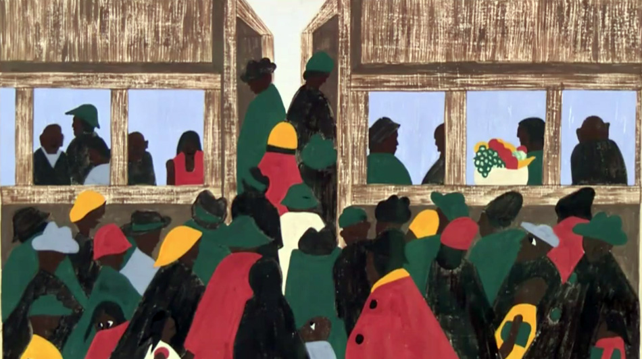
The Great Migrations Analyzed
1940-70: Second Wave
Today 1970-2000: New Wave
1910-40: First Wave

Slide 4
Methodology
Used webscraping to compose one large data set from multiple census.gov datasets
This data allowed us to analyze firstly the geographical change during each time period and the economic differences from the beginning of the Migration until the end of it
Queries from 1910-1940, 1940-1970, 1990-2000s

Slide 5
Datasets
Unfortunately, kaggle didn't have any datasets that could be used for reasearch. Thus, I had to find datasets from:
Census.gov Datasets
University Datasets

Slide 6
Hypotheses
Heading into this experiment, my initial hypotheses was that each migration helped bridge the economic gap between Blacks and other racial counterparts, but there remains a significant gap due to other reasons, like the resources gap.

Slide 7
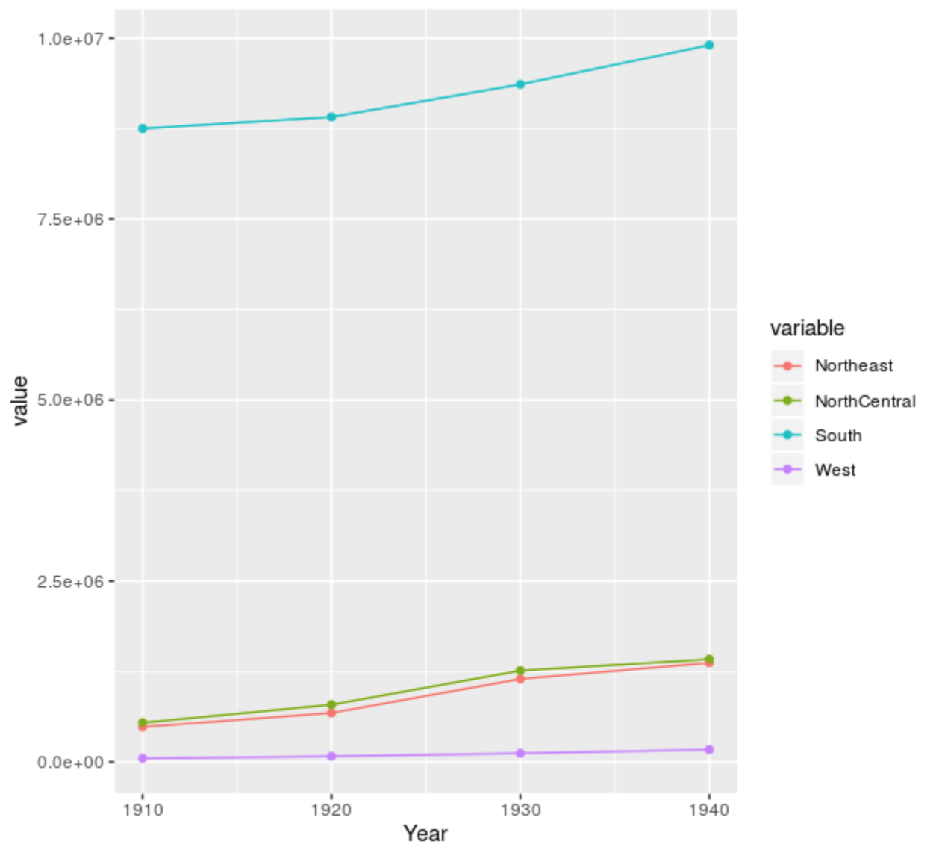
Results: First Migration
First Migration
Geographical-Section by regions(Northeast, North Central, South, West
Plot

Slide 8
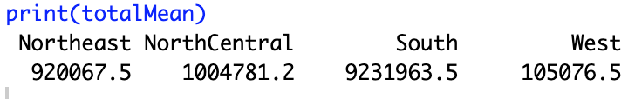


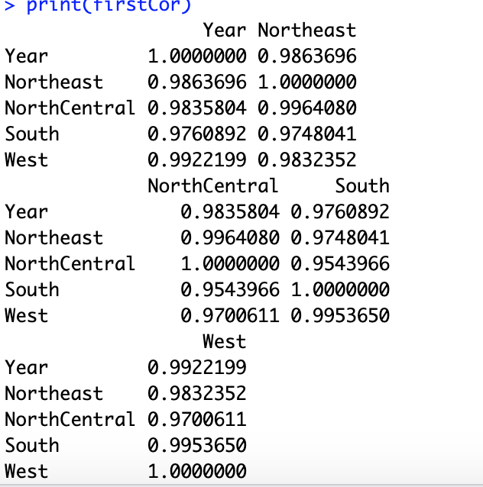
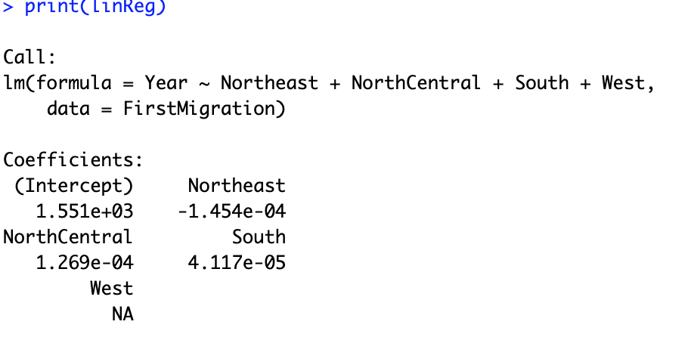
Results: First Migration
First Migration
Geographical-Section by regions(Northeast, North Central, South, West
Summary Stats
Mean
Median
Mode
Correlation
Linear Regression

Slide 9
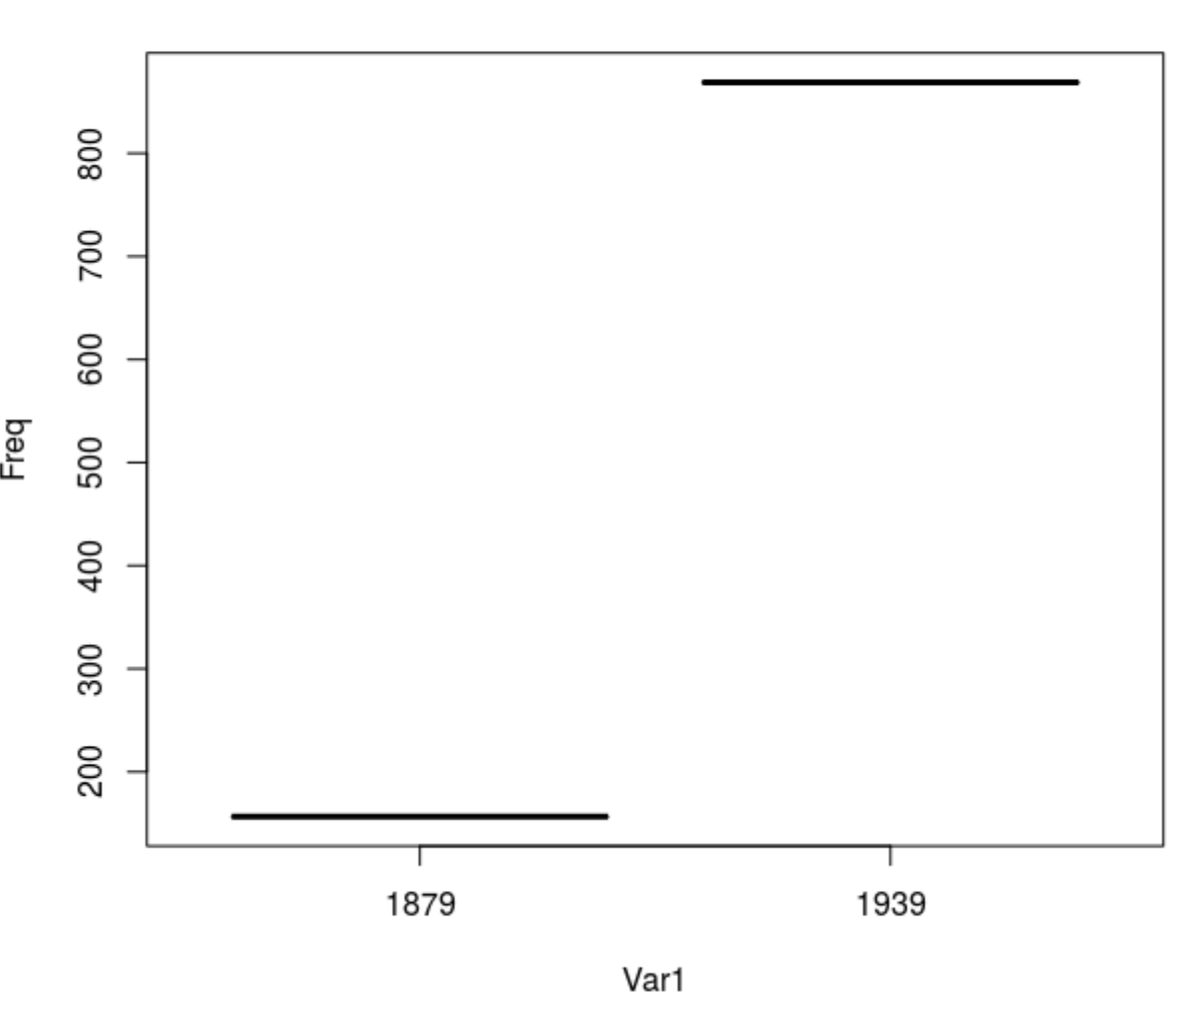
Results: First Migration
First Migration
Economical-Very little data available
Plot

Slide 10


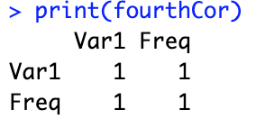
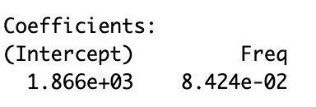
Results: First Migration
First Migration
Economical-Very little data available
Summary Stats
Mean
Median
Mode
Correlation
Linear Regression

Slide 11
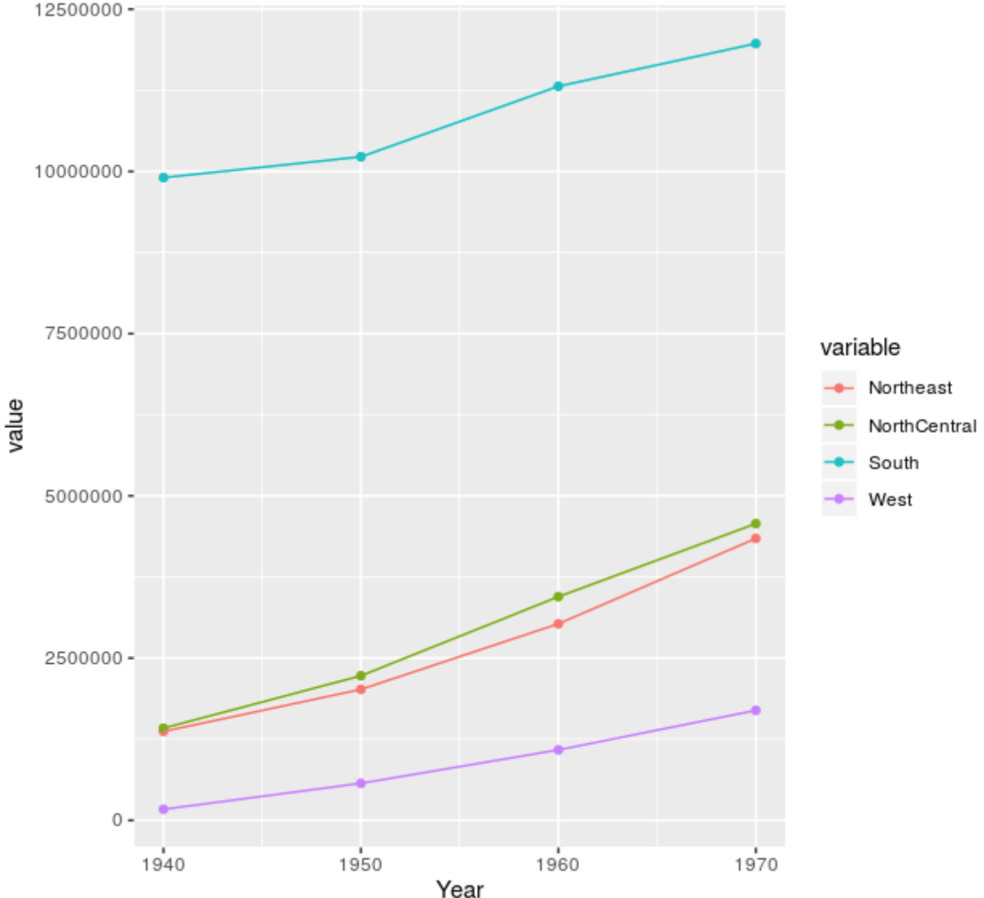
Results: Second Migration
Second Migration
Geographical-Section by regions(Northeast, North Central, South, West
Plot

Slide 12
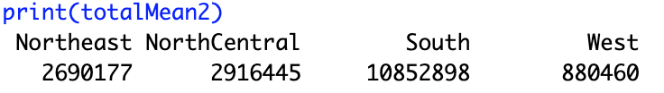


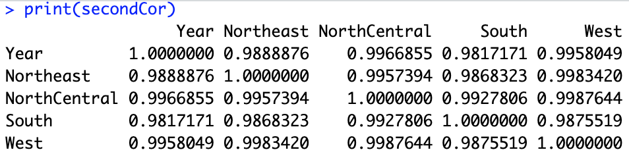
Results: Second Migration
Second Migration
Geographical-Section by regions(Northeast, North Central, South, West
Summary Stats
Mean
Median
Mode
Correlation
Linear Regression

Slide 13
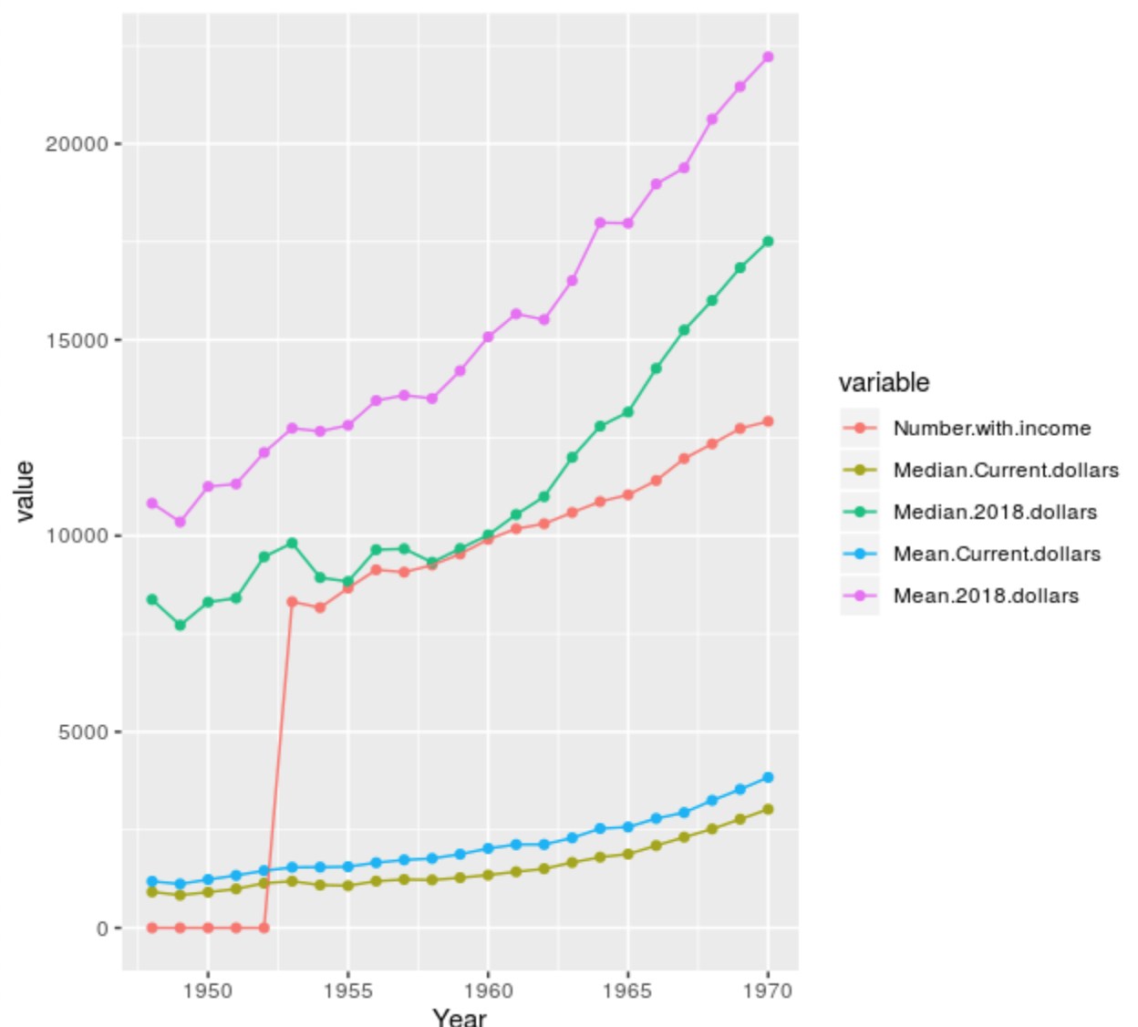
Results: Second Migration
First Migration
Economical
Plot

Slide 14
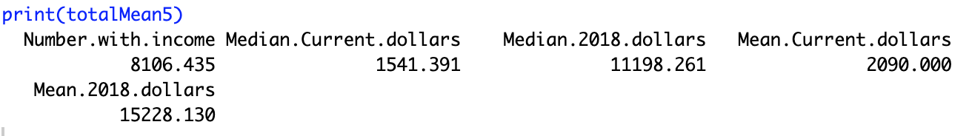
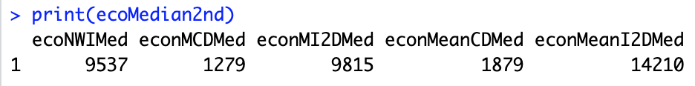

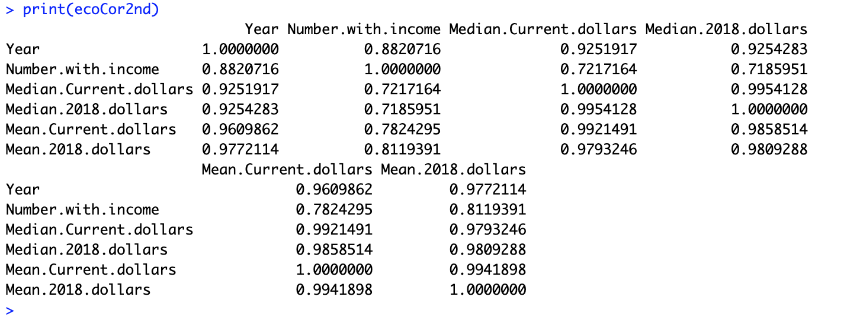
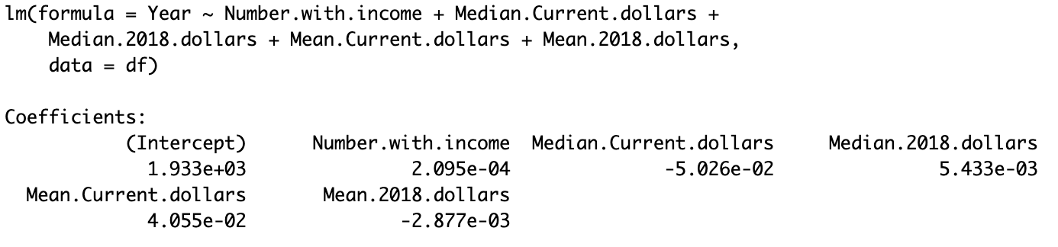
Results: Second Migration
Second Migration
Economic
Summary Stats
Mean
Median
Mode
Correlation
Linear Regression

Slide 15
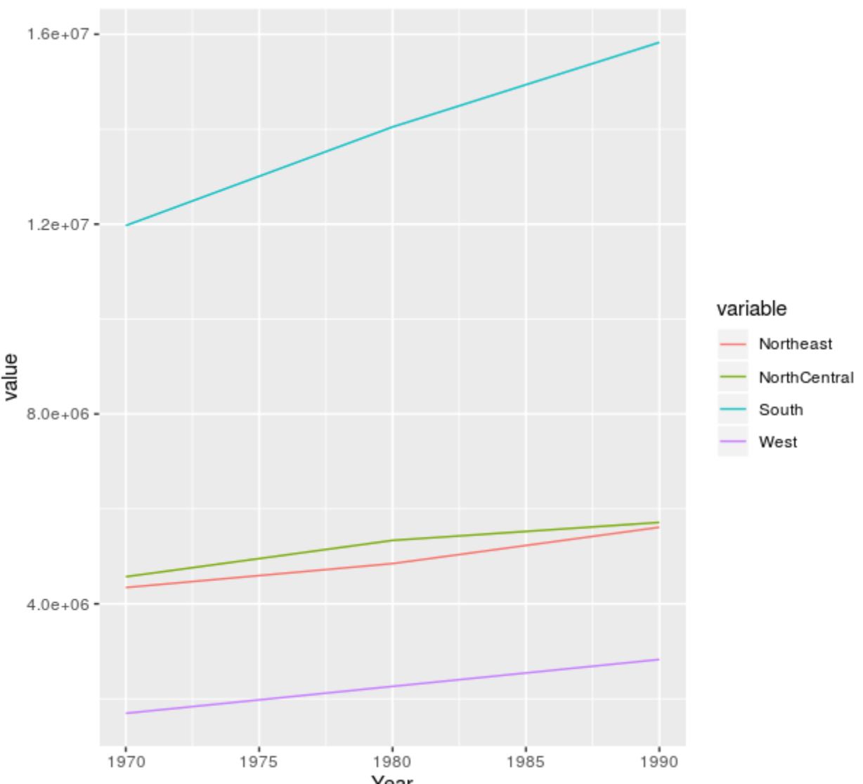
Results: Third Migration
Third Migration
Geographical-Section by regions(Northeast, North Central, South, West
Plot

Slide 16
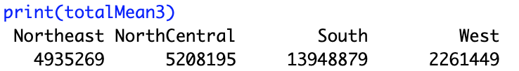


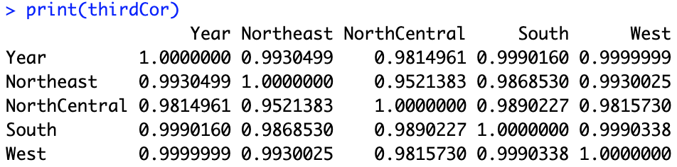
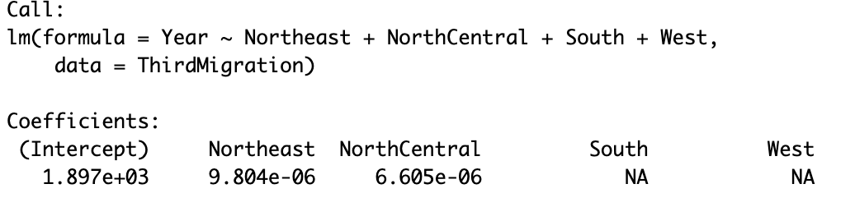
Results: Third Migration
Third Migration
Geographical-Section by regions(Northeast, North Central, South, West
Summary Stats
Mean
Median
Mode
Correlation
Linear Regression

Slide 17
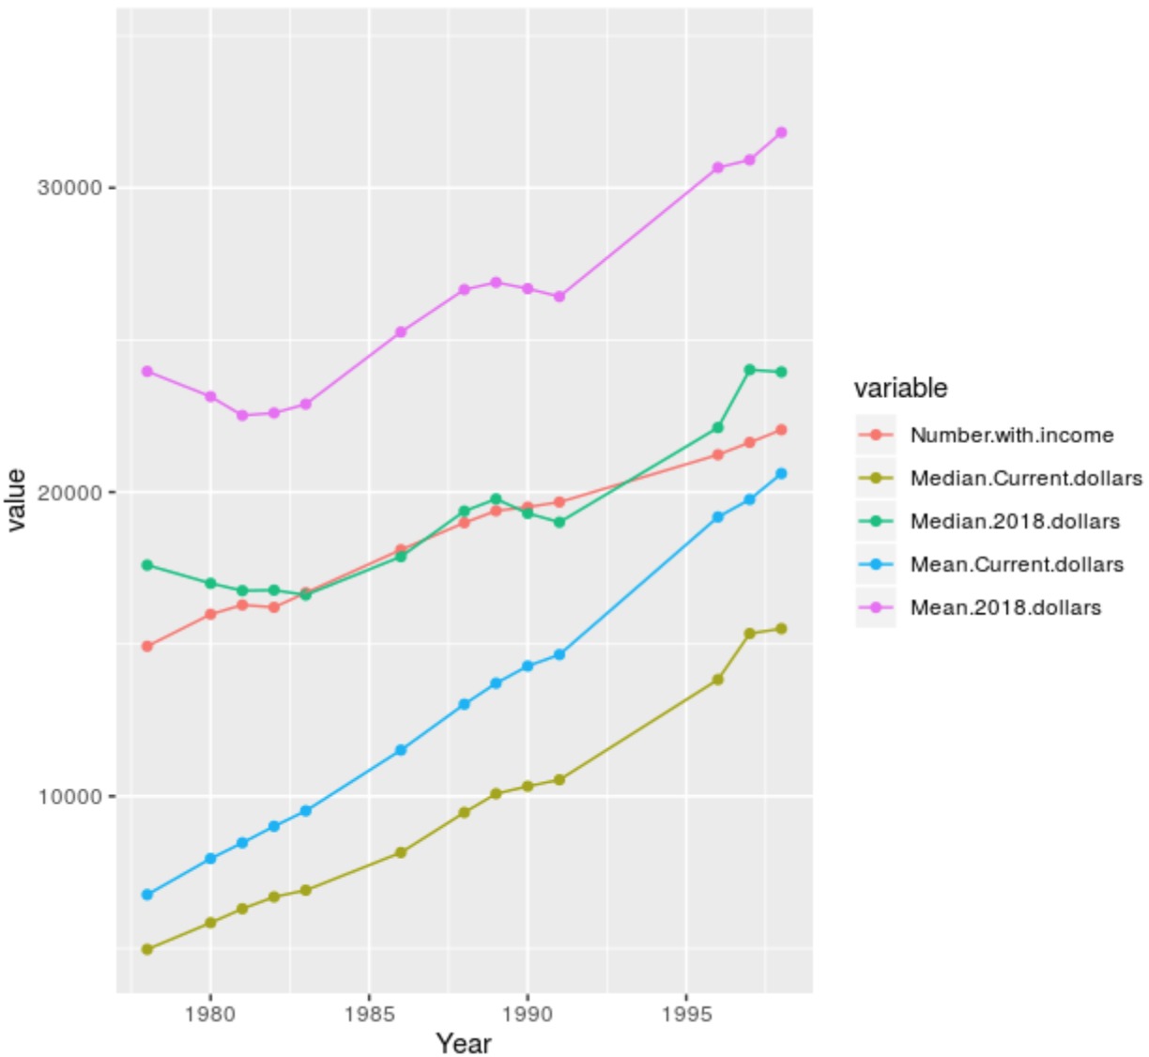
Results: Third Migration
Third Migration
Economical-Very little data available
Plot

Slide 18
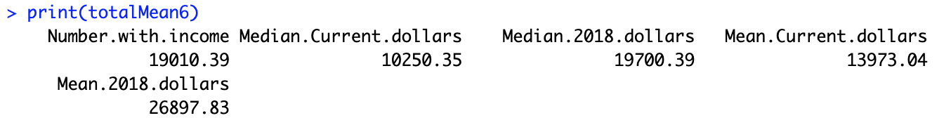

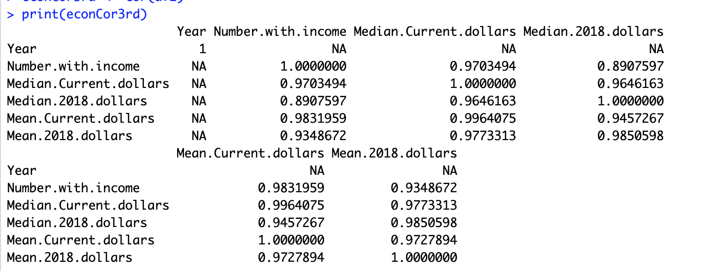
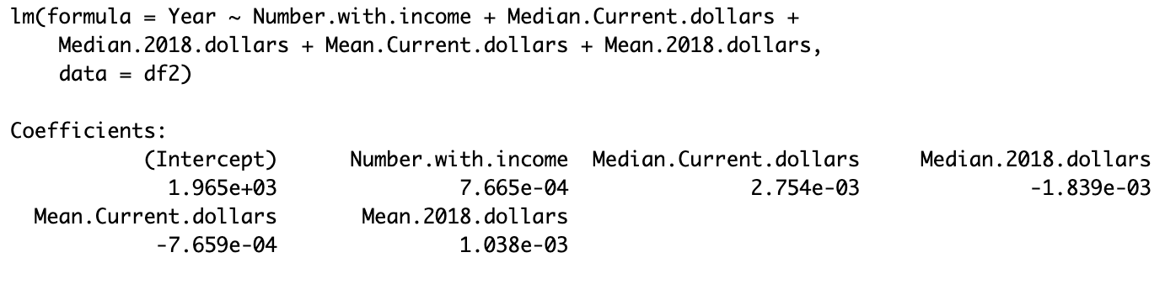
Results: Third Migration
Third Migration
Economical
Summary Stats
Mean
Median
Mode
Correlation
Linear Regression

Slide 19
Potential Discussions
What are the main factors from previous Migrations that made them Great ?
How does today's migration mimic the past Great Migrations ?

Slide 20
Conclusions
Study shows that many Blacks migrated mainly North during the First Migration. Then more blacks migrated towards the Western and Northern regions during the Second Migration. Blacks during today's migration are still steadily moving to each region with a majority making their way back South.
Study also supports the fact that Blacks migrating during each of the various time periods, aided to the economic growth of the race.

